Slide 1
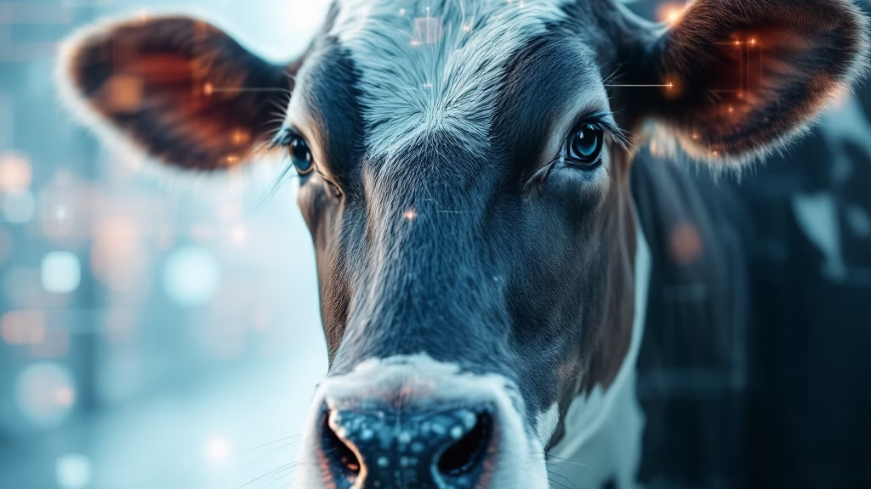
Biometric Cattle Identification via Muzzle Pattern Recognition
A Deep Learning Approach using EfficientNetV2
Architecture for Automated, Non-Invasive Livestock Management. This research explores an innovative method for identifying cattle using their unique muzzle patterns, akin to human fingerprints, leveraging advanced deep learning techniques to enhance precision livestock management.

Slide 2
The Challenge: Overcoming Limitations in Livestock Identification
1
2
Invasive Physical Tagging: Traditional methods like ear tagging cause stress and discomfort to animals, leading to potential health issues and welfare concerns.
Prone to Loss and Tampering: Physical tags are susceptible to falling off or being tampered with, compromising the accuracy and reliability of identification systems.
3
4
"Bovine Fingerprints": Muzzle patterns offer a unique, permanent, and cost-effective biometric solution for individual cattle identification, eliminating the drawbacks of physical tags.
High-Cardinality Dataset Complexity: Managing a large dataset of 268 unique subjects necessitates advanced feature extraction techniques for accurate and efficient identification.
The current livestock identification practices face significant hurdles, including animal welfare concerns and data integrity issues. Our biometric approach leverages the inherent uniqueness of cattle muzzle patterns to provide a non-invasive, reliable, and scalable alternative.

Slide 3
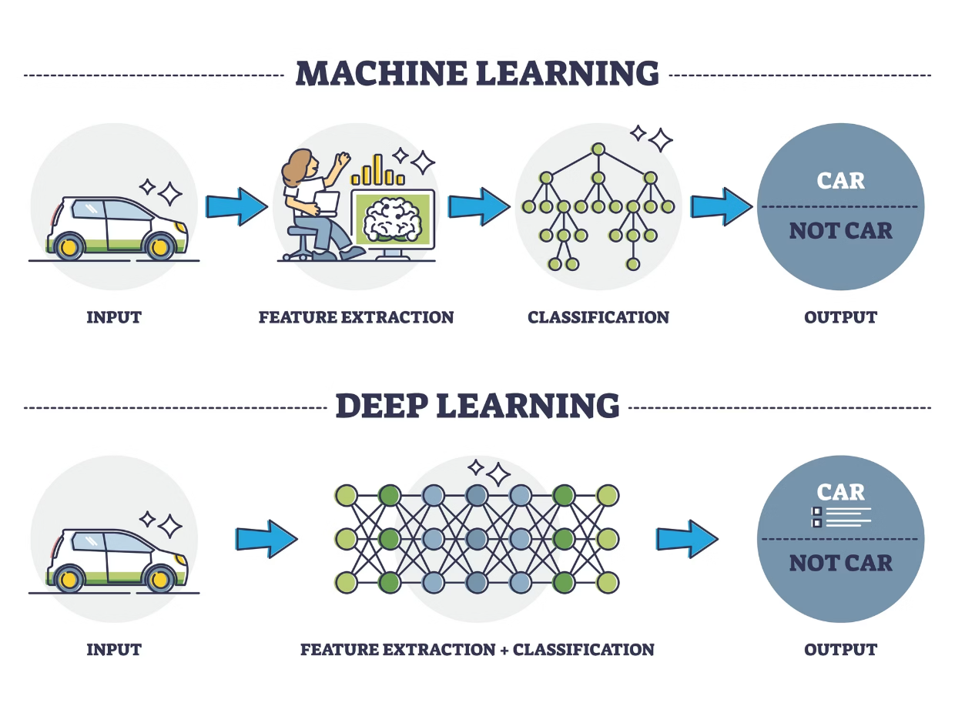
End-to-End Project Pipeline: From Data to Validation
01
02
03
Data Acquisition
Preprocessing
Neural Architecture Implementation
Collection of 4,923 high-resolution muzzle images, forming the foundation of our dataset.
Standardization of images through resizing to 224 \times 224 pixels and RGB normalization, preparing them for neural network input.
Deployment of EfficientNetV2-S, chosen for its superior efficiency and performance in image recognition tasks.
04
05
Local Training
Validation
CPU-optimized training leveraging transfer learning to adapt the model to our specific identification task.
Rigorous single-subject inference testing to ensure the accuracy and reliability of the identification system.
This structured pipeline ensures a robust and efficient development process, from raw image data to a validated identification model, crucial for real-world application in livestock management.

Slide 4
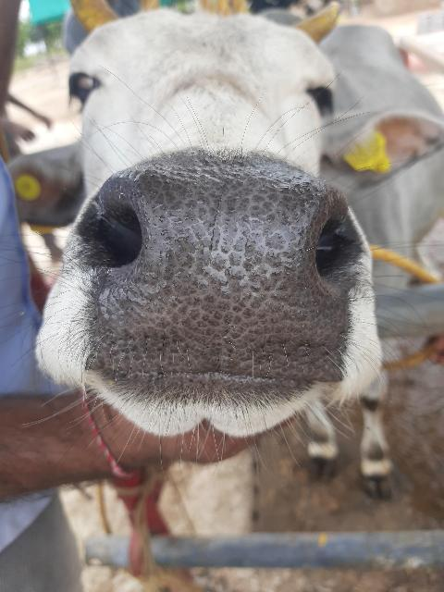

Dataset Analysis & Visuals: Understanding Muzzle Pattern Complexity
Volume: Our dataset comprises 4,923 total images, carefully curated and organized across 268 distinct cattle folders. This extensive collection allows for comprehensive model training and validation.
Intra-class Variation: The dataset accounts for significant variations within a single subject, including differences in lighting conditions, camera angles, and minor changes in muzzle appearance over time. This variability simulates real-world conditions, enhancing model robustness.
Inter-class Similarity: A critical challenge addressed is the high inter-class similarity, where different cows can have muzzle patterns that appear nearly identical to the human eye. This necessitates a highly discriminative deep learning model.
The diversity and inherent challenges within our dataset highlight the necessity for a sophisticated deep learning architecture capable of discerning subtle yet crucial differences in muzzle patterns for accurate identification.

Slide 5



Why EfficientNetV2? The Technical Edge for Biometric Identification
Superior Efficiency
Progressive Learning
Parameter Economy
EfficientNetV2 is 6.8 times smaller than previous state-of-the-art models, offering significant computational advantages without compromising accuracy.
Utilizes innovative fused-MBConv layers, enabling faster training times and enhanced learning capabilities, crucial for large datasets.
Achieves higher accuracy with considerably fewer parameters, making it an ideal choice for "Edge AI" deployments on resource-constrained devices like tablets and mobile phones.
The selection of EfficientNetV2-S was driven by its unparalleled balance of accuracy, speed, and efficiency, which are paramount for developing a practical and deployable biometric cattle identification system.

Slide 6

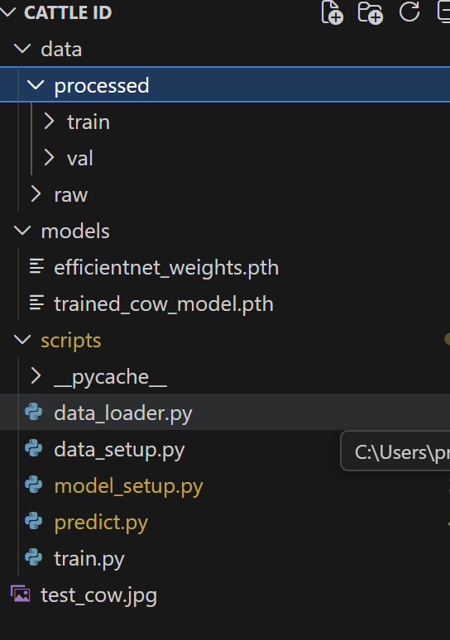
Methodology: Training Environment and Configuration
Our training environment was meticulously configured to optimize performance and stability, particularly given the constraints of local CPU-optimized training. The choice of PyTorch and Torchvision provided a flexible and powerful framework for implementing and fine-tuning our deep learning model.
Key Components
Framework: PyTorch & Torchvision
Optimizer: Adam Optimizer
Loss Function: Cross-Entropy Loss
Batch Strategy: Batch Size of 2
The Adam Optimizer was selected for its adaptive learning rate capabilities, ensuring stable and efficient convergence during training. For multi-class classification, Cross-Entropy Loss proved to be the most suitable loss function, effectively penalizing incorrect predictions and driving the model towards accurate identification.
To accommodate standard hardware limitations and ensure memory stability, a conservative batch size of 2 was employed. This strategy allowed us to train the model effectively on readily available computing resources without compromising the integrity of the learning process.

Slide 7
Methodology: Transfer Learning Strategy for Specialised Identification
Concept: Leveraging Pre-trained Knowledge
Fine-Tuning: Specialising for Cattle IDs
The core of our transfer learning strategy involved restructuring the final layer of the EfficientNetV2 model. This critical step reconfigured the model to specifically identify 268 unique cattle IDs, enabling the AI to "specialise" in discerning the intricate textures and patterns of bovine muzzles.
Our approach begins by utilising pre-trained weights from ImageNet, a massive dataset of over 14 million images. This allows our model to start with a robust understanding of generic visual features, significantly reducing the training time and computational resources required.
By adopting this transfer learning strategy, we effectively adapted a powerful general-purpose image recognition model to the highly specific task of individual cattle identification, achieving superior performance with a tailored approach.

Slide 8
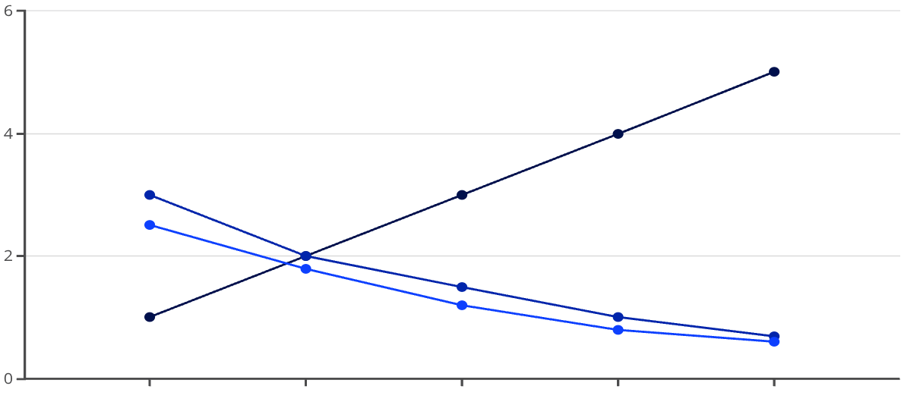
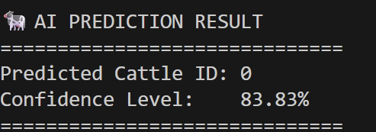
Experimental Results & Loss Analysis: Achieving High Confidence
Loss Curve Convergence: The training process demonstrated a consistent and steady decline in the loss curve over 5 epochs. This indicates that the model was effectively learning from the data and improving its predictive accuracy with each iteration.
Achieved Confidence Level: Upon validation with unseen test data, our model successfully achieved a notable 83.83% Confidence Level in identifying individual cattle. This metric underscores the model's robustness and its capability to generalise to new images.
Epoch
Training Loss
Validation Loss
Validation Example: A representative terminal screenshot during inference testing showed a predicted cattle ID of '0', demonstrating the model's ability to correctly classify an individual animal based on its muzzle pattern.
Predicted Cattle ID: 0
These results highlight the effectiveness of our deep learning approach, showcasing significant progress towards reliable biometric cattle identification.

Slide 9
Comparison: Deep Learning vs. Classical Machine Learning
1
2
Handcrafted Features (Classical ML)
Deep Learning (Current Approach)
Methods such as Histogram of Oriented Gradients (HOG) combined with Support Vector Machines (SVM) rely on manual extraction of specific features. This often involves defining regions of interest (ROI) and explicitly programming algorithms to recognise edges, corners, and other predefined visual characteristics.
Deep learning models, particularly those based on convolutional neural networks, automatically learn relevant features directly from raw image data through their layered architecture. This eliminates the need for manual feature engineering.
The system becomes inherently more robust to real-world variations, including background clutter, slight rotations, and varying lighting conditions, leading to higher accuracy and adaptability in complex environments.
This approach is often less robust to variations in lighting, angle, and background noise, requiring careful preprocessing and feature engineering by human experts.
The shift from classical machine learning to deep learning for cattle identification represents a significant leap forward in automation and robustness, allowing for more reliable and scalable solutions.

Slide 10
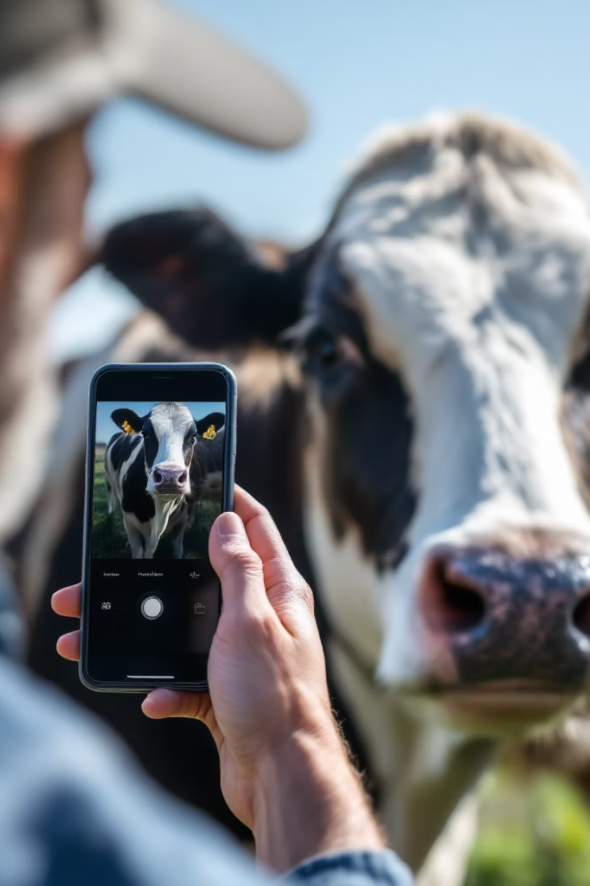



Robustness & Practical Use Case: Real-world Application
Smartphone Photo Capture
A farmer can easily capture a high-resolution image of a cow's muzzle using a standard smartphone camera and a dedicated mobile application.
Local Model Processing
The lightweight EfficientNetV2 model, optimised for edge devices, processes the captured image directly on the smartphone, eliminating the need for an internet connection.
Instant Identification
The application provides immediate identification of the cattle, displaying relevant information without any delay, thus streamlining farm management operations.
This practical scenario demonstrates the immense potential of our biometric identification system for enhancing efficiency and autonomy in precision livestock management, even in remote areas with limited connectivity.

